Slide 1
SESSION 3: Preparing to meet your future.
CLICK HERE TO CONTINUE

Slide 2
PREPARING TO MEET YOUR FUTURE
Preparation builds confidence and helps you make decisions.
People who are satisfied in their careers generally share certain characteristics:
They find the work meaningful.
They are using skills and talents they have developed.
They find the work interesting.
They feel they are fairly compensated.
That's why it's important to be aware of your values, skills, and interests. When you're clear about what's right for you, you'll be able to make decisions that lead you to a career that fits you. Work is an important part of life, so it needs to "work" for you.
The decisions you'll need to make to achieve the kind of career you want relate to:
The education and training you'll pursue
The kinds of volunteer activities you might take on
Your hobbies and activities
The people you spend time with
The income you will need to support your values and interests
CLICK HERE TO CONTINUE

Slide 3
SOFT SKILLS
When you plan for a career, it's important to prepare for the specific requirements of that career. It's just as important to develop your soft skills.
Soft skills are skills that are needed to do well in most jobs but that are not tied to a specific job.
All companies look for employees with strong soft skills.
Key soft skills include:
Communication
Responsibility
Perseverance
Taking Initiative
Critical Thinking
Collaboration
Leadership
We will explore each of these more in-depth in the next few slides.
CLICK HERE TO CONTINUE

Slide 4
SOFT SKILLS CONTINUED
Communication
Having skills to speak, write, and listen effectively: Strong oral and written communication skills, including active listening
I was asked to train a new employee. I made sure I had a complete list of everything that needed to be taught, listened carefully to her questions, and addressed her with clarity and respect.
Responsibility
Taking personal responsibility for choices and consequences
One hour before I was scheduled to be at work, my ride canceled. I knew I was responsible for finding a ride to work, even if it was inconvenient or uncomfortable for me, so I figured out a plan because I had to be at work.
CLICK HERE TO CONTINUE

Slide 5
SOFT SKILLS CONTINUED
Perserverance
Persevering (continuing to try) even when conditions are difficult
We were losing the game really badly at the half, but I still kept trying my best, even though it didn't look like we could be successful.
Taking Initiative
Seeing what needs to be done and doing it without being told to by others
I was given four hours to complete a task. I finished early and took the initiative to do other work without being asked.
CLICK HERE TO CONTINUE

Slide 6
SOFT SKILLS CONTINUED
Critical Thinking
Thinking and evaluating issues objectively to make decisions
When my manager was out at a meeting and a coworker called in sick, I had to figure out how to redeploy staff to keep things running smoothly. I came up with a new schedule for the day
Collaboration
Working with others effectively to achieve a common goal
My coworkers and I had to meet a tight deadline. We worked together to decide how to divide up the work, and all of us put the job ahead of our personal needs. We supported each other when there were problems and we got everything done on time.
CLICK HERE TO CONTINUE

Slide 7
SOFT SKILLS CONTINUED
Leadership
Positively influencing others when necessary
My coworkers were complaining loudly about work and gossiping about other workers while customers were nearby. I persuaded them to figure out how to get the work done and lower their voices.
CLICK HERE TO CONTINUE

Slide 8
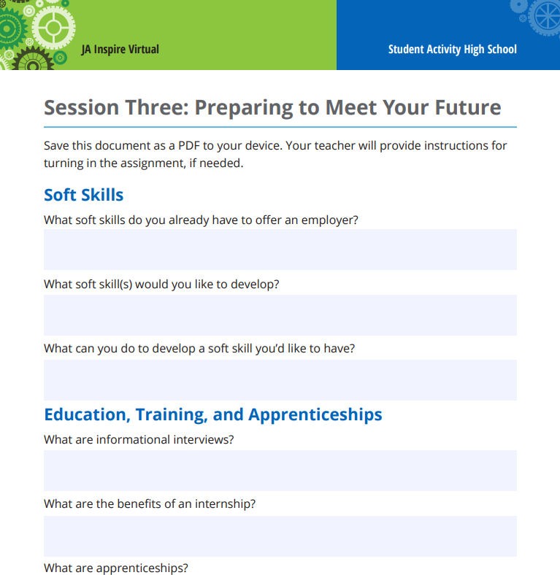
COMPLETE THE ACTIVITY
EDUCATION, TRAINING, AND APPRENTICES
Having a career that suits your values, skills, and interests requires planning. An important part of any plan is getting relevant education and training. Will you need technical certification for your career? A 2-year or 4-year degree? Graduate school? What are the costs and options to pay for the education and training you will need?
As you explore career options, pay attention to the educational requirements. The foundation you build through training and education will have a major impact on your career options.
WORKSHEET
Open the Preparing to Meet Your Future worksheet.
Answer the questions about soft skills.
CLICK HERE TO CONTINUE

