Slide 1
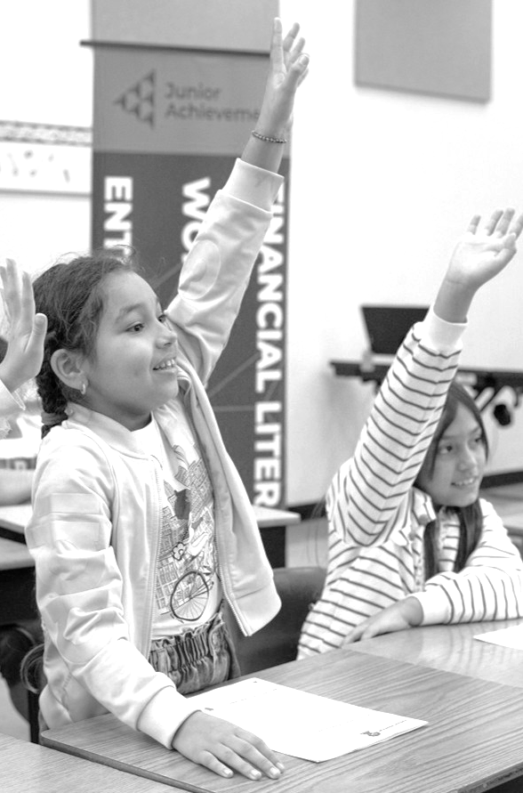

JA VOLUNTEER
ORIENTATION
Thank you for volunteering!
Notes:
INTRODUCTION: WELCOME AND MEETING EXPECTATIONS
SAY: Welcome everyone and thank you for becoming a JA volunteer.
ASK: This is an interactive training! We kindly request that you please turn on your cameras during this training.
“Who will be the first brave soul to turn on their camera?”
DO: Have the volunteers check in by typing their name in the chat to take attendance easily.
SAY: This orientation session will walk you through the basics of your upcoming volunteer experience and the next steps necessary to get ready.

Slide 2

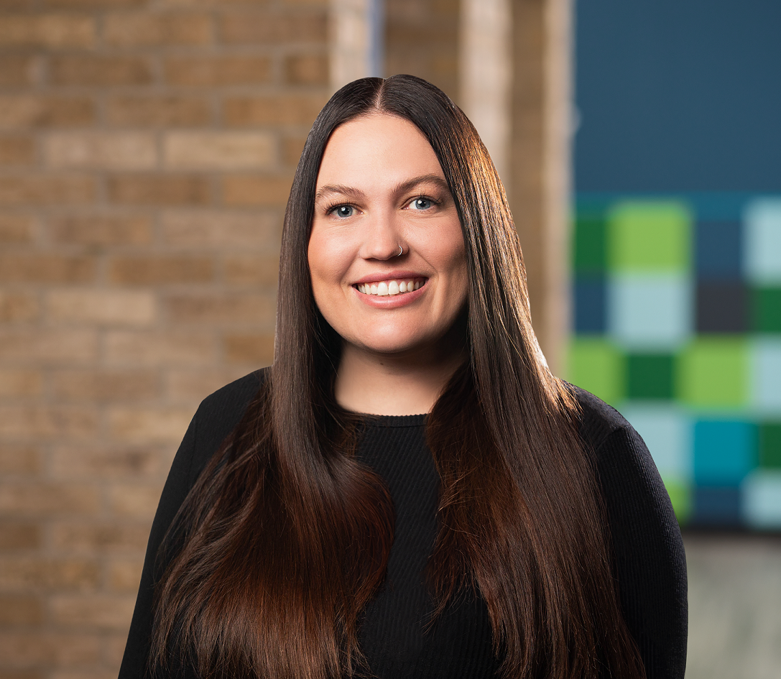




TODAY’S FACILITATOR
ADRIAN RAMOS
AdrianR@jaaz.org
MICAELA BARBER
MicaelaB@jaaz.org
TAYLOR SCHULTE
TaylorS@jaaz.org
NAME
Title
NAME
Title
LAUREN ALLEN
LaurenA@jaaz.org
MIRIAM ROBLES
MiriamR@jaaz.org
NAME
Title
Notes:
INTRODUTION: ABOUT THE TRAINER
DO: Introduce yourself and tell the volunteers your title and some of the duties of your job.
Share a little bit about yourself but keep it short.

Slide 3
TODAY’S FACILITATOR
ADRIAN RAMOS
AdrianR@jaaz.org
MICAELA BARBER
MicaelaB@jaaz.org
TAYLOR SCHULTE
TaylorS@jaaz.org
NAME
Title
NAME
Title
LAUREN ALLEN
LaurenA@jaaz.org
MIRIAM ROBLES
MiriamR@jaaz.org
NAME
Title
Notes:
INTRODUTION: ABOUT THE TRAINER
DO: Introduce yourself and tell the volunteers your title and some of the duties of your job.
Share a little bit about yourself but keep it short.

Slide 4
TODAY’S FACILITATOR
ADRIAN RAMOS
AdrianR@jaaz.org
MICAELA BARBER
MicaelaB@jaaz.org
TAYLOR SCHULTE
TaylorS@jaaz.org
NAME
Title
NAME
Title
LAUREN ALLEN
LaurenA@jaaz.org
MIRIAM ROBLES
MiriamR@jaaz.org
NAME
Title
Notes:
INTRODUTION: ABOUT THE TRAINER
DO: Introduce yourself and tell the volunteers your title and some of the duties of your job.
Share a little bit about yourself but keep it short.

Slide 5
TODAY’S FACILITATOR
ADRIAN RAMOS
AdrianR@jaaz.org
MICAELA BARBER
MicaelaB@jaaz.org
TAYLOR SCHULTE
TaylorS@jaaz.org
NAME
Title
NAME
Title
LAUREN ALLEN
LaurenA@jaaz.org
MIRIAM ROBLES
MiriamR@jaaz.org
NAME
Title
Notes:
INTRODUTION: ABOUT THE TRAINER
DO: Introduce yourself and tell the volunteers your title and some of the duties of your job.
Share a little bit about yourself but keep it short.

Slide 6
TODAY’S FACILITATOR
ADRIAN RAMOS
AdrianR@jaaz.org
MICAELA BARBER
MicaelaB@jaaz.org
TAYLOR SCHULTE
TaylorS@jaaz.org
NAME
Title
NAME
Title
LAUREN ALLEN
LaurenA@jaaz.org
MIRIAM ROBLES
MiriamR@jaaz.org
NAME
Title
Notes:
INTRODUTION: ABOUT THE TRAINER
DO: Introduce yourself and tell the volunteers your title and some of the duties of your job.
Share a little bit about yourself but keep it short.

Slide 7
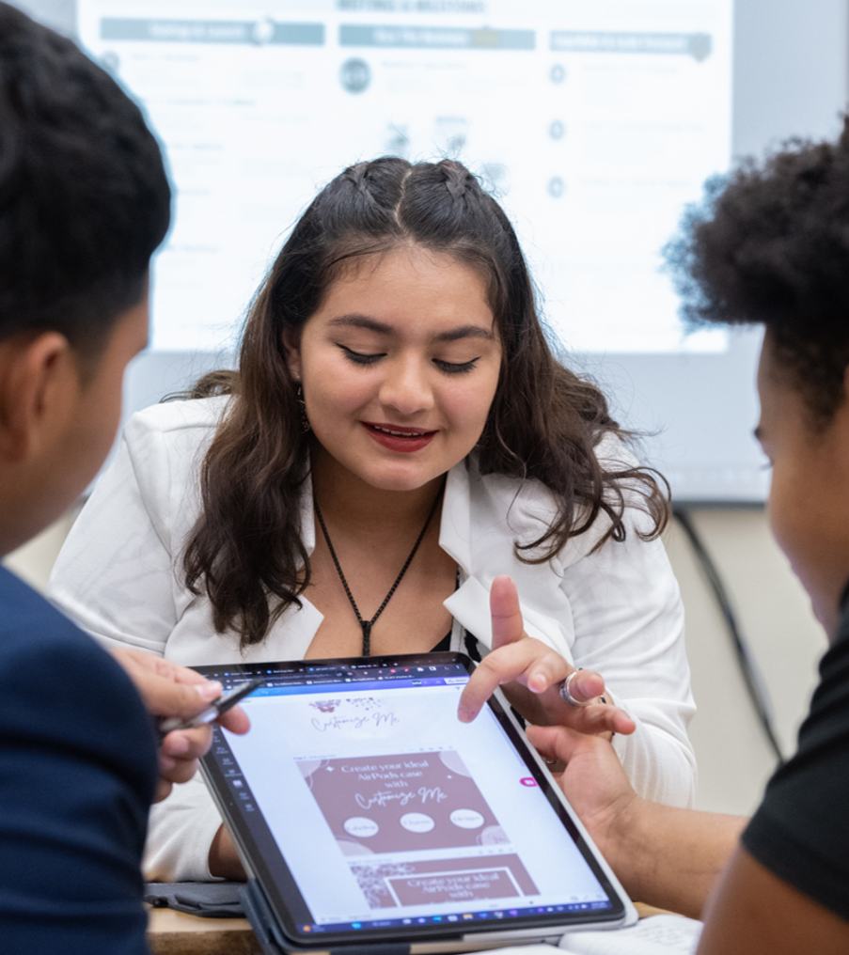
WELCOME!
With the help of our volunteers, Junior Achievement prepares AZ students to succeed in work and life by:
  CONNECTING their education to real world experiences
  BUILDING their confidence and durable skills
  EXPLORING future opportunities
  EMPOWERING them towards future economic mobility
THIS SESSION’S PURPOSE IS TO...
  INTRODUCE you to JA's In-Classroom opportunities
  PREPARE you for interacting with students
  REVIEW the resources you will use to prepare
  EXPRESS our gratitude
Notes:
INRODUCTION: ABOUT JA
ASK: Has anyone here heard about/participated in Junior Achievement before?
If YES, ASK them to take a short moment to talk about their experience and/or why they decided to come back.
IF NOT, SAY: That is okay! Today, we are going to make you into JA experts!
Quickly review some JA facts for all the newbies and
SAY :
JA is a non-profit that has been in AZ for over 65+ years and is all over the US.
Our mission is to prepare AZ students to succeed in work and life by:
CONNECTING their education to real world experiences
BUILDING their confidence and durable skills
EXPLORING future opportunities
EMPOWERING them towards future economic mobility
This session is to get you started for an in-class experience. You will not be fully ready after this training – you will need to get ready for your specific experience, but this orientation is to help ensure you have all the tools needed to do so and provide you with support along the way.
This will include:
Preparing you to interact with students
Reviewing the resources you will use
and of course, say thank you!
SAY:
Our volunteers are so important because they bring their own experiences from their professional careers, real-life knowledge, and know-how that cannot be replicated or replaced.
For you to donate your time is extremely valuable, and our programs would not have the impact they do without you.

Slide 8
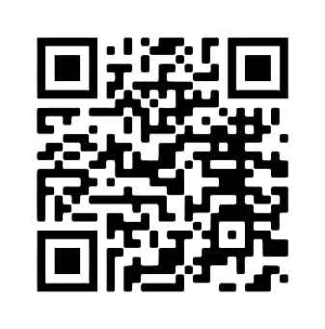
JA Volunteer Agreement
Please take a few minutes to read and sign the Volunteer Agreement by scanning the QR code.​
This is required before entering the classroom.
www.jaaz.org/volunteer-agreement-form/
Notes:
INTRODUCTION: JA VOLUNTEER AGREEMENT
ASK: Please fill out this volunteer form if you have not already.
NOTE: Per JA USA: We must verbally confirm the following with new volunteers.
SAY:
This form establishes some guidelines for you as a volunteer entering a classroom.
Remember that you are working with young people under the age of 18. They look to you as an example of appropriate behavior, such as respect, honesty, integrity, and professionalism.
You must use appropriate language. Any profanity, sexualized, or derogatory language is prohibited.
Make sure not to share your personal contact information with students under any circumstances, including email, phone, or social media accounts, or requests to follow you on social media.
If students have questions for you after you leave the classroom, they can ask their teacher, and the teacher can reach out to you.
Taking photographs/videos of members or participants, guests, volunteers, or students is prohibited.
Volunteers agree to follow all safety and health guidelines required by the school districts and institutions where they volunteer.
Volunteers are encouraged to review and ask questions about any of the JA Volunteer policies.

Slide 9

What’s one way you used MONEY in the last year that you feel particularly good about?
WE’RE SO GLAD YOU’RE HERE!
What is a SKILL that you’ve developed that you feel is important for young people to learn?
Share your NAME + ORGANIZATION
Who is one person who INFLUENCED your future?
Use this strategy:
Ask questions to make connections
What inspired you to volunteer with JUNIOR ACHIEVEMENT?
Notes:
INTRODUCTION: ICEBREAKER
SAY: Now that we’ve learned a little bit about JA, let’s learn some more about each other with an icebreaker.
DO:
Read aloud the questions or give the volunteers a moment to read them over.
Have each person share their name, org/department (if everyone is from the same org), and answer one of the questions on the screen.
If you have a large group (10+), get answers from 2-3 volunteers and/or have other folks share in the comments.
For smaller groups, go around the room and have all volunteers share their response.
After the volunteers answer a question, ask them a “Why?” follow-up. Model how we want volunteers to interact with students in the classroom.
Virtual Tip: This is another good time to take attendance as the volunteers say their names/check the Zoom room of who is present.
CLICK the screen so that the blue box pops up:
READ the strategy to the volunteers.
SAY:
This exercise was not just a fun icebreaker but an example of how open-ended questions can help build rapport as a presenter.
It’s important to build rapport with your students early on. You are a new face they’ve never seen before and taking time to stop and get to know each other is a great way to engage the students in the learning.

Slide 10

JA shapes their future. YOU change their future.
90%
98%
By 2031, 70% of jobs will require education or training beyond high school.*
TEACHERS REPORT THAT THEIR STUDENTS ARE MORE MOTIVATED in school following a JA experience.
OF JA ALUMNI ATTRIBUTE JA TO THE BELIEF “education is important as it relates to future success”.
81%
1 in 5
In Arizona about 1 in 4 high school students DO NOT GRADUATE.**
OF JA ALUMNI report having stronger financial footing.
JA ALUMNI WORK in the same field as their JA volunteer.
*Georgetown University Center on Education and the Workforce, 2022
**Education Forward Arizona, 2024
Notes:
INTRODUCTION: JA IMPACT STATISTICS
SAY:
BY 2031, 70% of jobs will require their employees to have some sort of education beyond high school.
The fact that about 1 in 4 AZ High School Students don't graduate, means that a good portion of AZ students are not being set up for success when they enter the working world.
But JA Alumni defy the odds and show better performance in and outside of school
DO: Share some of the stats on the screen.
96% of JA Alumni say that they were positively influenced by the program.
Teachers say that participating in JA leads to an increase interest in school from students, which increases their chances of staying in the school system and graduating.
You, our volunteers, get to help make that difference and allow our programs to be as successful as they are.

Slide 11

IN-CLASSROOM PROGRAMMING
BRINGING THE REAL WORLD
INTO THE CLASSROOM
JA volunteers partner with educators to bring career-connected learning experiences directly to students.
  Different than other JA Learning Experiences like JA BizTown or JA Finance Park
Experiences help students connect education to future opportunities, explore careers and pathways, build confidence and self-efficacy, and practice important life and workplace skills.
YOUR ROLE AS THE VOLUNTEER
You are not expected to be a teacher. You are a role model who helps students connect classroom concepts to real-world experiences.
The educator remains in the classroom with you and JA provides the materials and guidance needed to facilitate the experience.
Notes:
INTRODUCTION: ABOUT JA’S IN-CLASSROOM PROGRAMS
SAY:
You have signed up for JA’s “In-Classroom” Programs.
This is where JA sends volunteers to go into a school or learning facility to deliver programs. (K-12th grade).
This is ONE of the departments within JA. We have others that include JA BizTown, JA Finance Park, and our rural initiatives.
DO: Ensure volunteers are clear about their roles.
As a volunteer, you are not expected to be a professional teacher or to have teaching experience.
You are coming in as a role model use pre-developed materials to facilitate various games or lessons with students.
The teacher will be in the classroom with you the entire time.

Slide 12
VOLUNTEER TIMELINE
KEY
COMMUNICATION
Volunteers are sent last minute reminders and make final preparations for their event day.
Last-minute changes may be communicated, so keep an eye on your email! If a volunteer drops out, it impacts the WHOLE experience!
CONNECTING
WITH JA
Volunteer Signs-Up for an In-Classroom JA Experience.
GETTING
MATERIALS
Volunteers are assigned a classroom/grade level. Materials are available for volunteers. Materials might be physical, virtual, or BOTH.
VOLUNTEER
TIME!
Volunteers arrive for their school visits and make an impact with students. Visits can be one-time or spread over a few weeks.
POST-
VOLUNTEERING
Volunteers verify their involvement with a Completion Statement Form. Volunteers stay in the JA Family and return for future volunteer events
PRACTICING
AND PREPARING
Volunteers have time to review and prepare for their upcoming event. This is the time to go through kit of materials, watch any videos provided, and plan for the day. Please coordinate with your partner if applicable.
EDUCATOR
CONNECTION
Volunteers are connected to their educator and can ask any pertinent questions before their JA visit(s).
ATTENDING THE ORIENTATION
New volunteers attend a one-time volunteer training and completes their Volunteer Conduct Policy (required for EVERY School Year).
Notes:
INTRODUCTION: THE JA VOLUNTEER TIMELINE
SAY:
As new JA volunteers, it is important to understand what to expect. We want you to know what you are signing up for and what to expect as a volunteer.
Here is a timeline for what the typical volunteer journey looks like.
CLICK
SAY:
The first step is connecting with Junior Achievement to volunteer; this could be through your company, someone you know, or independently.
CLICK
SAY:
Next is the step we are at currently, which is attending a JA Volunteer Orientation. These trainings are a requirement for new volunteers before entering into the classroom. If you do not attend, then we cannot allow you into a classroom.
We will also have you complete the volunteer form. This form will be required every school year.
CLICK
SAY:
After this training is over, you will receive communication from your JA staff contact about receiving a classroom and grade assignment if you have not already. You will also receive access to a digital copy of your FACILITATOR GUIDE (more on how to use that later).
You will also be given information about receiving physical materials.
CLICK
SAY:
Once you have your assignments and Facilitator Guide, it is time to review and prepare. This training will provide resources and tips on how to best do that.
It is also important that you connect with your partner if you have one, decide how you want to divide the prep work to make things easiest for you.
CLICK
SAY:
Your JA point of contact will be sending you important information throughout the entire process. Including any last-minute changes like classroom assignment changes. These often happen because of volunteers dropping at the last minute.
We understand emergencies happen and we want to stress, that if you cannot make it to your volunteer event, please let us know ASAP. When we are short volunteers, students run the risk of not receiving vital JA programming and we want to ensure we make the appropriate adjustments so that does not happen.
CLICK
SAY:
You will be introduced to your assigned educator before going into the classroom. Make sure you ask them any questions you want to know about their class—they’re going to know their students the best.
CLICK
SAY:
Then comes time to volunteer!
Know that whether your volunteer session is a one-time activation or a multi-week visit, you will have the support of not only JA Staff but your educator as well!
CLICK
SAY:
Lastly, we know you will have such a wonderful and fulfilling time as a JA volunteer that we hope you stay informed about our events and volunteer again because Arizona students need mentors like you in the classroom.

Slide 13
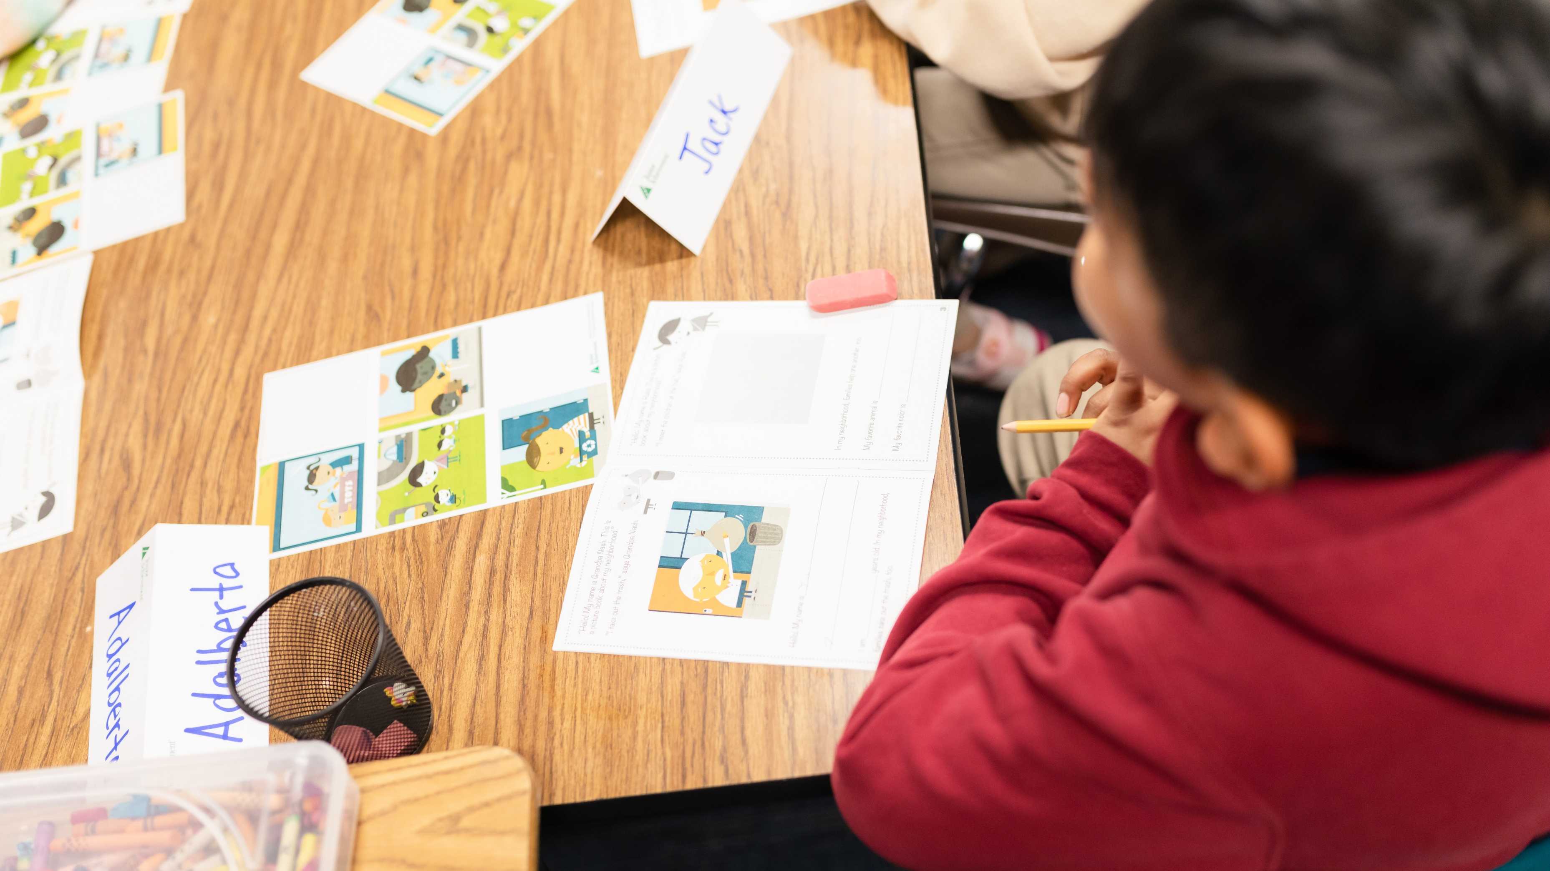
JA MATERIALS
Get to know what you’ll be teaching in the classroom.
Notes:
TRANSITION: REVIEWING MATERIALS
SAY:
Now that you know a little more about what to expect, let’s dive into the next part of the timeline and review the materials you will be using.

Slide 14
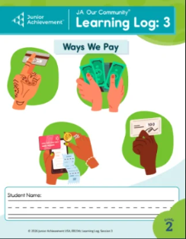
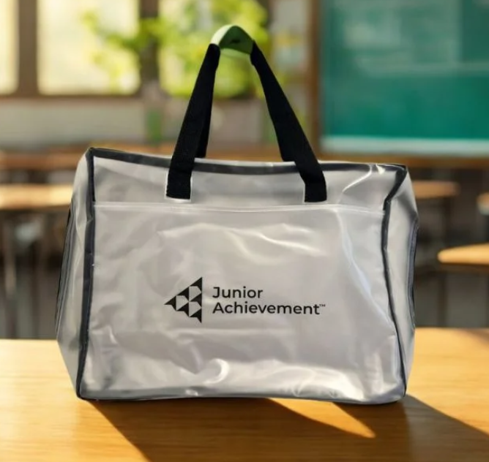
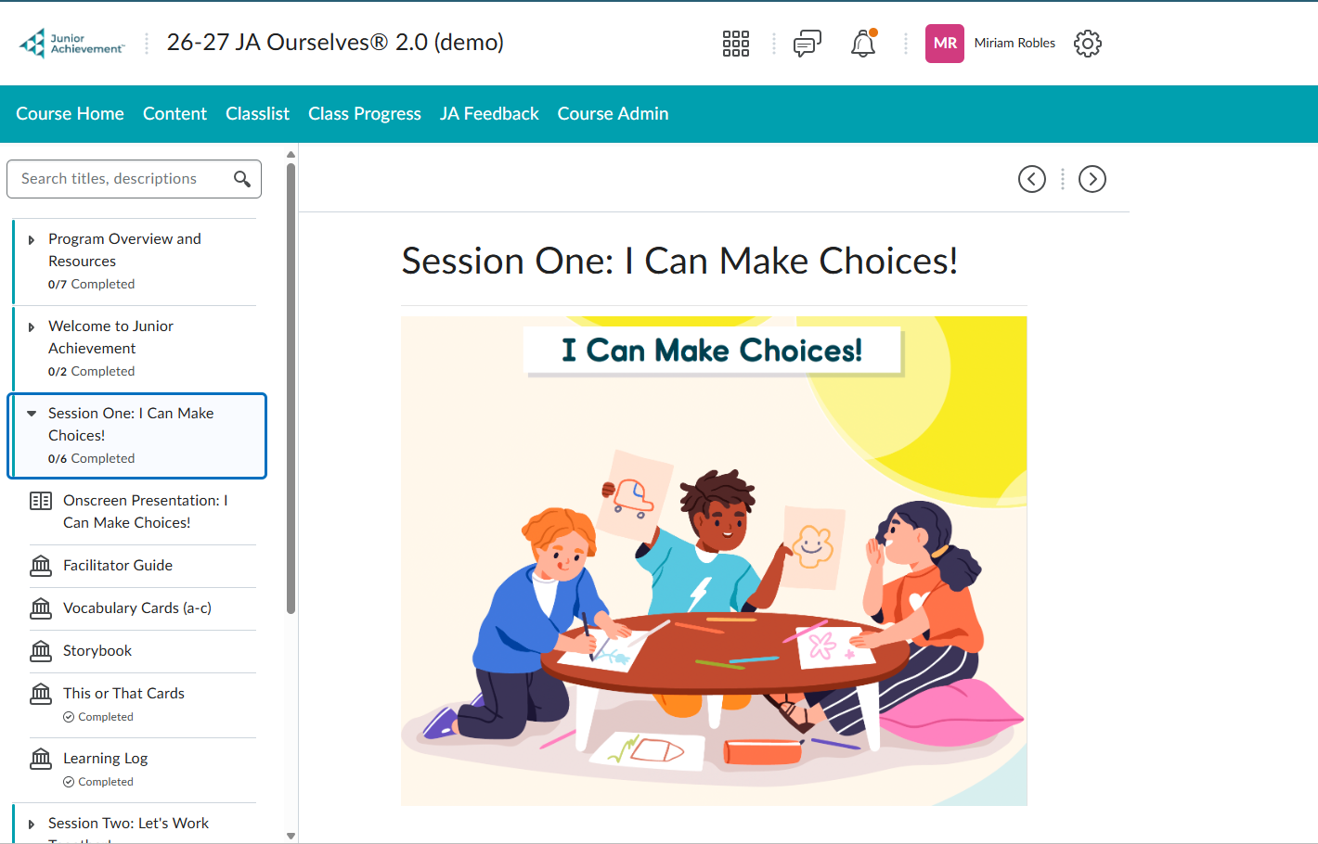

YOUR VOLUNTEER TOOLKIT
A PEEK INSIDE:
Hands on Material:
Interactive student materials may include learning logs, game pieces, job cards, and other tools to bring the concepts to life during activities and discussions.
Digital Resources:
Online presentation slides, videos, or tools to support your preparation and lesson delivery.*
Facilitator Guide:
The facilitator guide provides step-by-step instructions, talking points, and tips so you can confidently prepare and teach every lesson.
Your JA Kit contains everything you'll need to prepare for and facilitate your JA experience.
Notes:
PREPARE: MEET THE KIT
SAY:
As a JA volunteer, you are not going into the classroom empty-handed.
All our JA Volunteers will receive full-developed curriculum that not only includes an instructional guide but everything else you will need when entering a classroom.
All these items are contained in a JA-branded bag which we call a “KIT”
DO: Point out the kit
SAY:
You should receive your kit before going into the classroom.
Most kits are distributed 1-2 weeks prior to a JA visit; however, some programs rely on reusable materials that your JA contact will provide for you at the school, such as STEM Summits or JA MIM Lite.
Regardless of when you receive your kit, it is important to be familiar with what is inside.
DO: Use the laser pointer feature to highlight each item
Each kit will contain:
Hands-on materials that will be distributed to students by JA volunteers
Directions for accessing digital resources like presentation slides or video links that volunteers will use in the classroom.
Your FACILITATOR GUIDE, which is the step-by-step instructions that will guide you through the lesson.
The FACILITATOR GUIDE is thorough, easy to follow, and is what makes it possible for someone with no teaching experience to go into a classroom and be a successful volunteer mentor.
Let’s take a closer look at what to expect in your FACILITATOR GUIDE and how to use it.

Slide 15

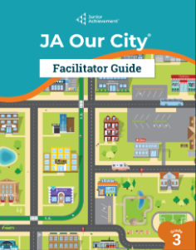
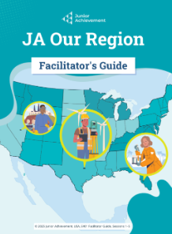

Why Junior Achievement?
MEET YOUR FACILITATOR GUIDE
FACILITATOR GUIDES are guides that contain the SESSIONS (lessons) that make up the program you will be facilitating.
The SESSIONS in each guide are made up of the same elements:
Overview
Objectives
Detail of preparation needed
Recommended time
Materials
Step-by-step instructions
Places/suggestions to personalize
Talking points
Learn how to use one guide, and you can use them all!
Notes:
PREPARE: FACILITATOR GUIDE REVIEW
SAY:
Regardless of what JA program or model you participate in, you will always receive a FACILITATOR GUIDE.
These are guides that contain the SESSIONS (or LESSONS) that make up the program you will be facilitating or teaching
ALL JA Program Guides will follow the same structure and contain the following elements:
Overview /Objectives
Details of preparation needed
Recommended time
Step-by-step instructions
Places/suggestions to personalize
You don’t need to memorize anything; the guide tells you what to say, what to ask, what to hold up, and when.

Slide 16
Why Junior Achievement?
REVIEWING YOUR FACILTITATOR GUIDE
We will be going through an example to explain the structure of a JA Facilitator Guide.
Follow along with your
Facilitator Guide if you have it!
Use this strategy:
Use modeling when giving instructions
Notes:
REVIEWING THE FACILITATOR GUIDE (cont.)
SAY:
Let’s walk through some of the key features across all facilitator guides to see:
how the guides are organized,
what you will always find,
How to read each section,
And how the design supports you during your session.
DO: Encourage volunteers to follow along with their own guides if they have them and keep an eye out for the key features you will be highlighting.
CLICK the screen so that the blue box pops up:
READ the strategy to the volunteers.
SAY:
Whenever you are giving directions in the classroom, make sure to use modeling so students can see the instructions in action. We’re going to model the key features to look for in your facilitator guide, so that when you are preparing to volunteer, you know what to look out for.

Slide 17
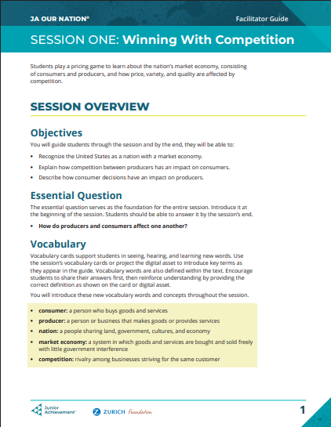
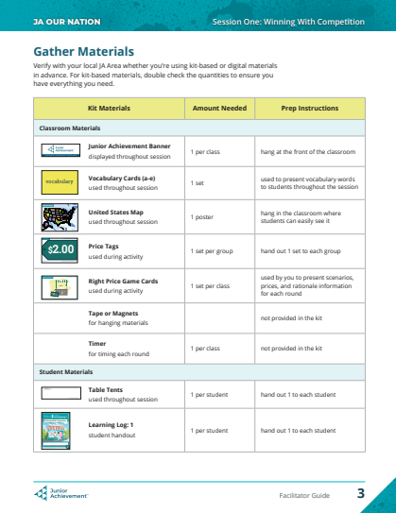
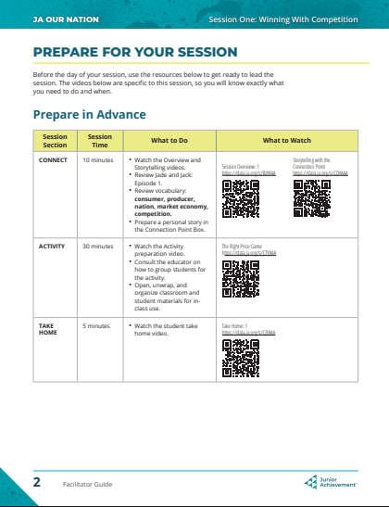
FACILITATOR GUIDE WALKTHROUGH
Session Materials
Session Overview
The Session Overview provides a quick snapshot of the lesson.
Notes:
FACILITATOR GUIDE WALKTHROUGH:
CLICK
SAY:
The guide starts with the session overview
CLICK
DO: Read text it appears
CLICK
SAY:
The essential question or learning objective that guides the session…
CLICK
SAY:
…and key vocabulary that you will introduce.

Slide 18
FACILITATOR GUIDE WALKTHROUGH
Prepare for your Session
Session Overview
Inside:
Breaks down each part of the session:
Introduction/Connect
Activity
Wrap-up/Take-Home
Suggested Timing
Notes:
FACILITATOR GUIDE WALKTHROUGH (CONT.):
SAY:
The “Prepare” section of the guide includes a list of step to take BEFORE entering the classroom that will ensure your success
CLICK
SAY:
Each session is divided into three parts:
The introduction/connection point
The activity
The Wrap-up/Take-home
CLICK
SAY:
The guide will also include suggestions for how long you should spend on each part of the session. Sessions vary in length from 30-45 minutes depending on the age group.

Slide 19
FACILITATOR GUIDE WALKTHROUGH
Gather Materials
Prepare for your Session
This tells you:
What items are in your kit
How many you need
What to do with each one
Notes:
FACILITATOR GUIDE WALKTHROUGH (CONT.):
CLICK
SAY:
The “”Materials” section tells you exactly what items you will be using in the classroom…
CLICK
SAY:
How many you will need…
CLICK
SAY:
And what to do with each one.
You will use this list to sort and organize your materials BEFORE the lesson starts

Slide 20
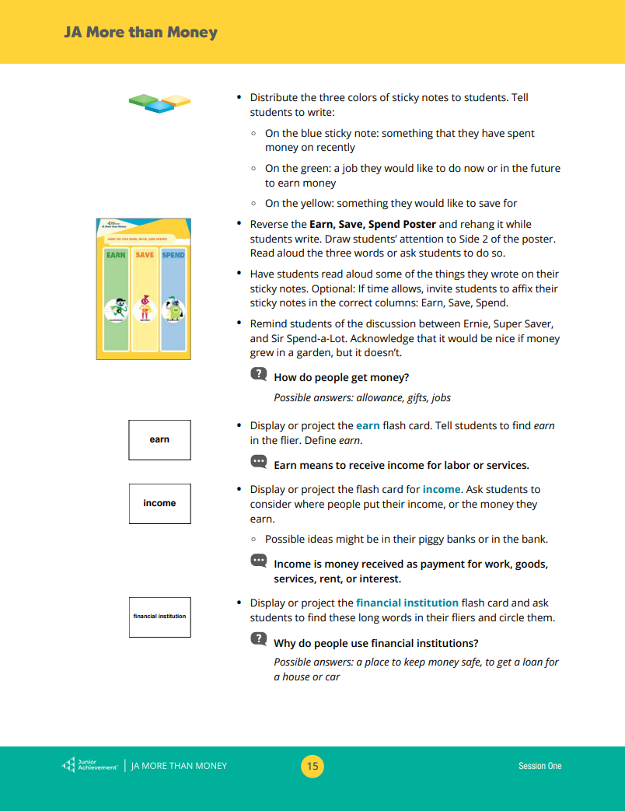
FACILITATOR GUIDE WALKTHROUGH
Vocabulary
&
Materials
Notes:
FACILITATOR GUIDE WALKTHROUGH (CONT.):
CLICK
SAY:
Vocabulary words will be highlighted right as they appear through the sessions, so you do not have to go looking for them.
CLICK
SAY:
Material images in the margins show you what to use and when, helping you stay in sync with the activity as you go.
If there is a virtual presentation that accompanies your program, you will see the corresponding slides along the margins too.

Slide 21
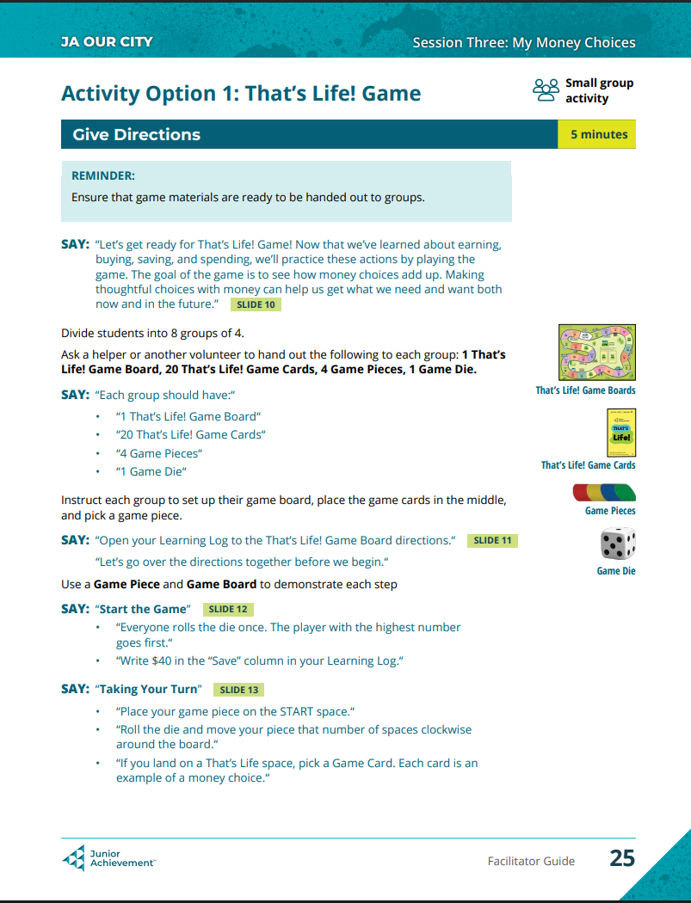
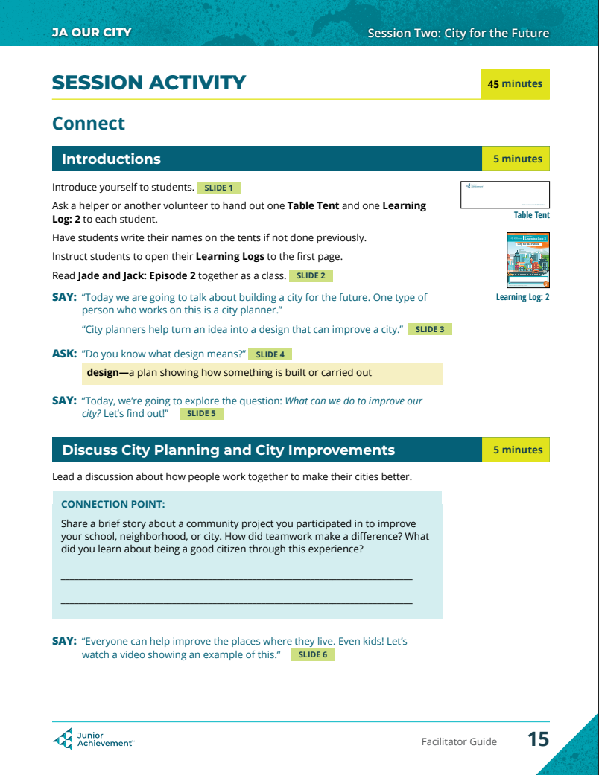
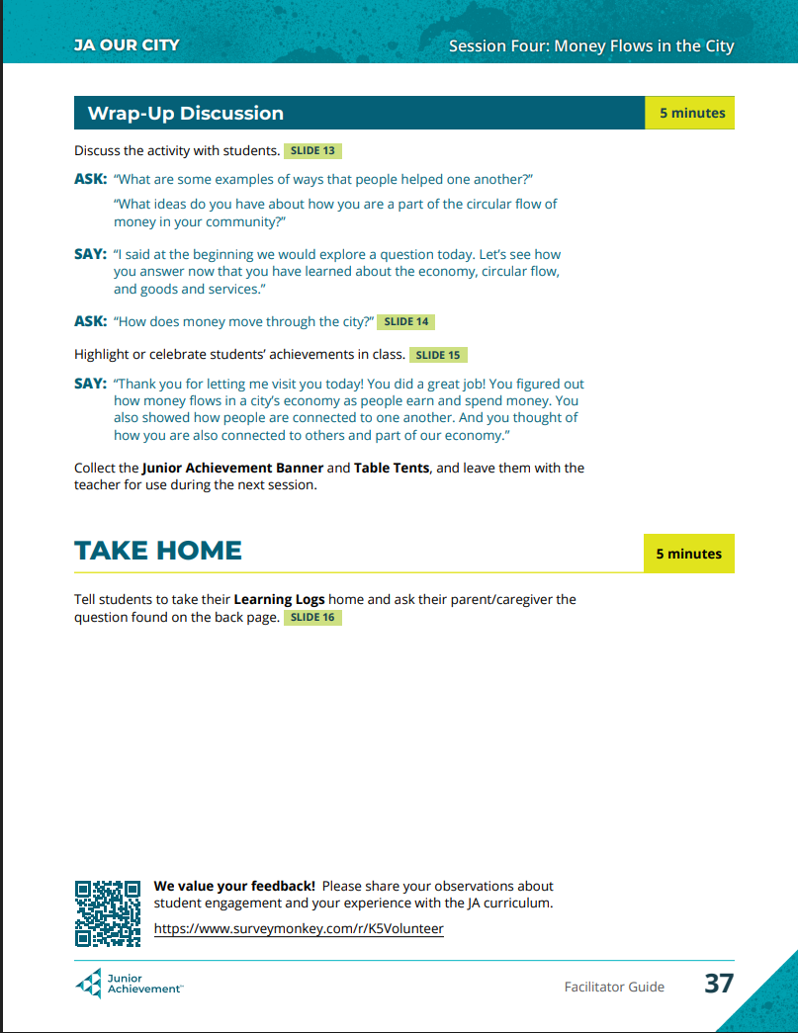
FACILITATOR GUIDE WALKTHROUGH
Introduction/Connection
Wrap-Up/Take Home
Activity
Notes:
FACILITATOR GUIDE WALKTHROUGH (CONT.):
SAY:
The session guide is where you will spend the most time while teaching. It is organized in three parts…
CLICK
SAY:
The Introduction/Connection point
CLICK
SAY:
The Activity
CLICK
SAY:
The Wrap-Up/Take-Home
Each part walks you through facilitating the session step-by-step.

Slide 22
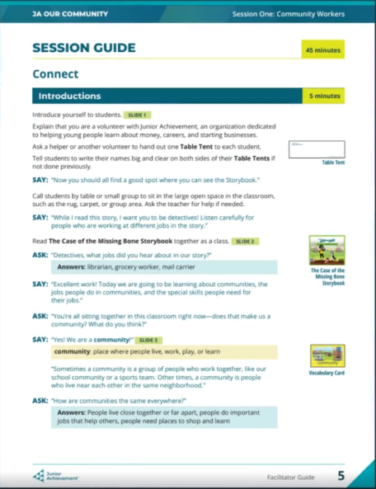
FACILITATOR GUIDE WALKTHROUGH
Introduction - Connect
Provides:
Volunteers the opportunity to connect with students by prompting them to share a short story about themselves.
Introductions for key concepts and vocabulary through guided discussion.
A Set up the Activity
Notes:
FACILITATOR GUIDE WALKTHROUGH (CONT.):
CLICK
SAY:
This is where you introduce yourself. There are Connection points that will prompt you to share a short personal story tied to the session topic.
It could be about your first job, something you are saving up for in the future, or a time you interacted meaningfully with your community.
It is a quick way to connect what students are learning to real life.
Feel free to write down ideas in your guide.
CLICK
SAY:
This is also where key concepts and vocabulary is introduced and you will lead a discussion.
CLICK
SAY:
The introduction is important because it creates rapport between you and the students while setting up the activity.

Slide 23
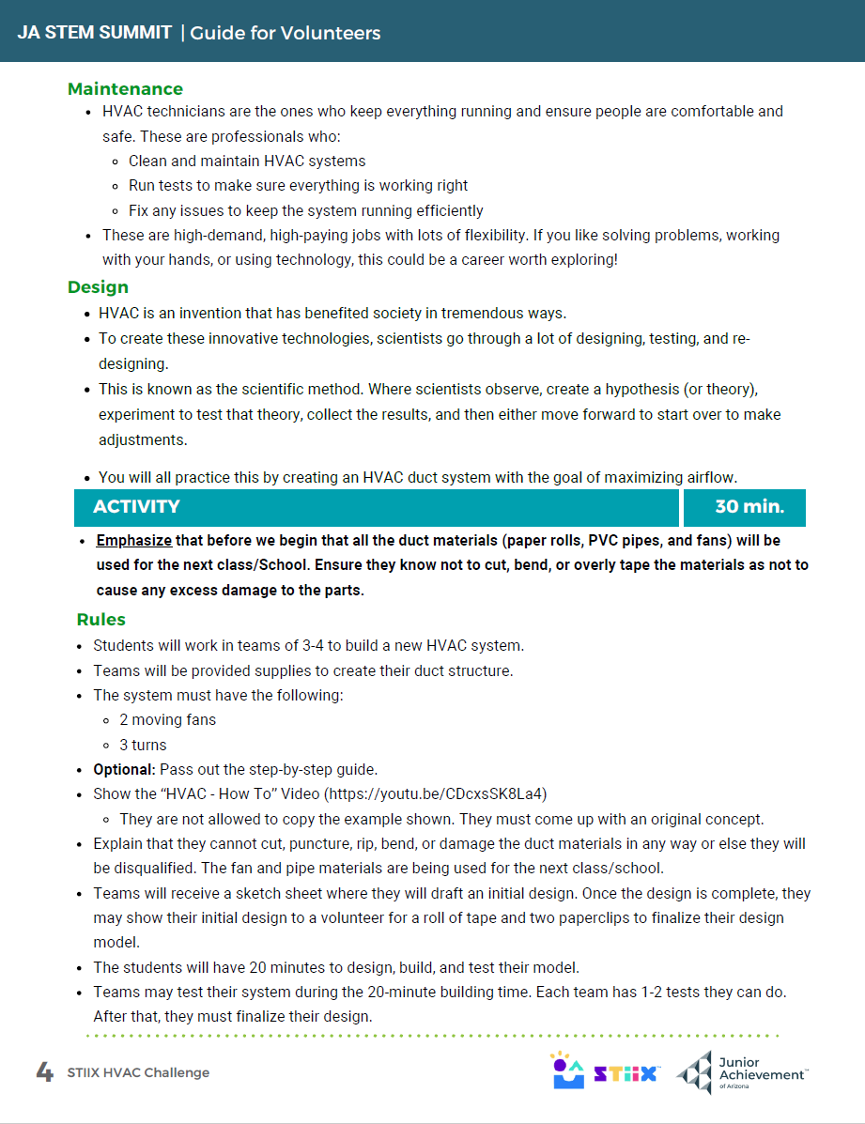
FACILITATOR GUIDE WALKTHROUGH
Activity
Provides:
Step-by-step directions
Timing
Notes:
FACILITATOR GUIDE WALKTHROUGH (CONT.):
SAY:
The activity is the longest portion of every session.
CLICK
SAY:
Every Activity section of a guide will include step-by-step directions for facilitating the hands-on activities.
CLICK
SAY:
And suggested timing from start to finish
ASK: Why would it be important to explain directions before handing out materials?

Slide 24
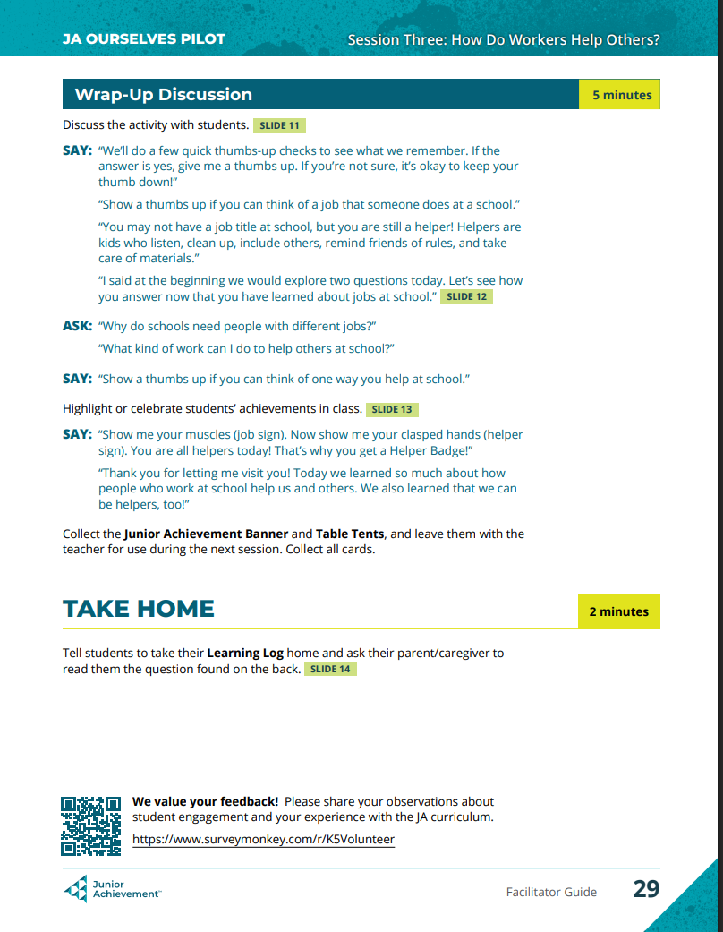
FACILITATOR GUIDE WALKTHROUGH
Wrap – Up
Provides:
Discussion that brings students back to their learning objective.
Take Home resources to share with family members and spark discussion.
Notes:
FACILITATOR GUIDE WALKTHROUGH (CONT.):
CLICK
SAY:
The wrap-up discussion brings students back to the learning objective from the introduction and helps them process what they’ve learned.
CLICK
SAY:
The Take Home portion closes the session by pointing students towards resources that are intended to be shared with their families that will keep the discussion going even after the JA Experience has been completed, ensuring the important topics stick.

Slide 25

CLICK
SAY:
FACILITATOR GUIDE
Key Takeaways
Review the facilitator guide before your session(s).
Use the guide in whatever way feels natural.
  reading directly or paraphrasing,
  The guide helps to stay on track and feel supported.
Stay true to the core of the lesson as best as you can.
Remember to stay present with the students!
Notes:
FACILITATOR GUIDE KEY TAKEAWAYS:
SAY:
As you are looking through your facilitator guide it is important to remember:
CLICK
SAY:
Review your facilitator guide before each session. You can write in, high light, or use sticky notes as you go.
CLICK
SAY:
Use the guide in whatever way feels natural.
Whether you are reading directly from the guide or paraphrasing, what matters most is that volunteers stay on track and feel supported.
CLICK
SAY:
It is important to stay true to the core of the lesson matters even as you put your own spin on how you get there.
CLICK
SAY:
And most importantly, remember to stay present with your students!
ASK: If there are any questions about the Facilitator Guide

Slide 26
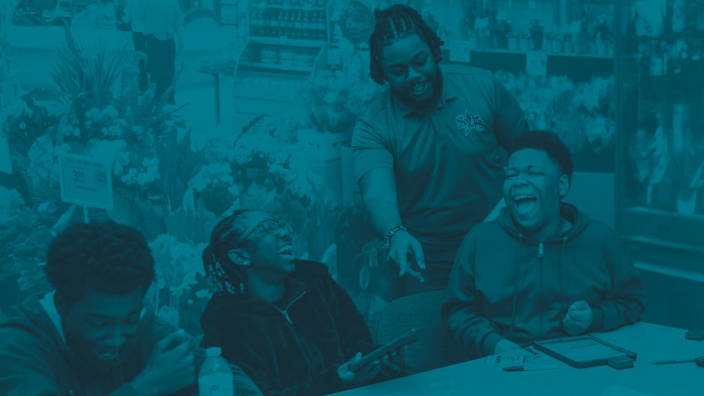
STUDENT
ENGAGEMENT
Student engagement is the key to your success in the classroom.
Different age groups will need different engagement approaches.
Notes:
TRANSITION: STUDENT ENGAGEMENT
SAY:
Understanding the Facilitator Guide is only the first part of being a JA Volunteer.
Being able to keep students engaged is the key to your success in the classroom and the JA Program overall.
It is the engagement and the connection that the students feel with the volunteers that they’ll remember more than anything.
Student engagement strategies are going to vary depending on the age of the students.
Let’s take some time to look at what to expect from and how to best engage the three age groups you will be interacting with as a JA Volunteer.

Slide 27
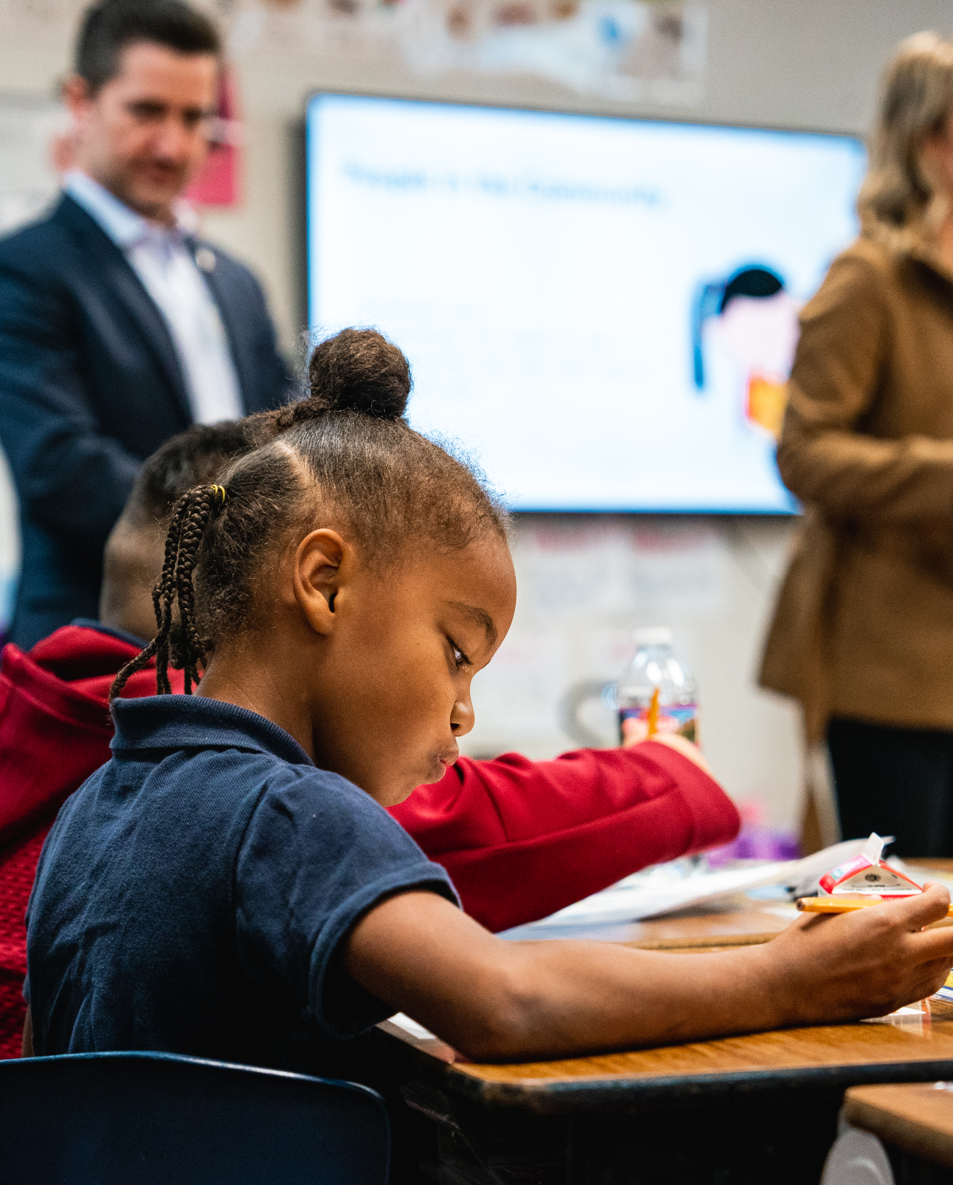
Elementary School Engagement
Elementary School Students:
Are Eager to participate
Learn best through interaction & repetition
Respond well to enthusiasm & encouragement
Need frequent reminders & redirection
Notes:
STUDENT ENGAGEMENT: ELEMENTARY
SAY:
Elementary school students are going to be in grades K – 5
This group is generally:
Eager to participate
Respond when to enthusiasm and encouragement
Get easily distracted and might need frequent reminders and gentle redirection

Slide 28
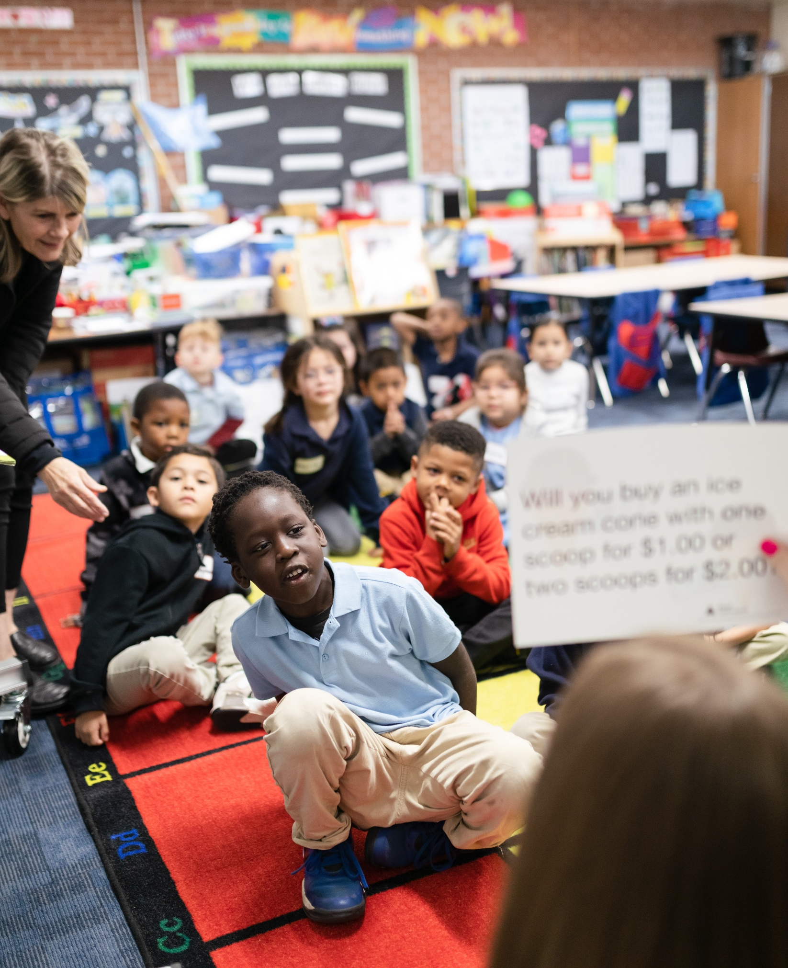
Elementary School Engagement
Engagement Tips:
Keep instructions clear & simple
Use call-and-response techniques
Praise often
Keeps students moving & involved
Use everyday examples they can relate to
Notes:
STUDENT ENGAGEMENT TIPS: ELEMENTARY
SAY:
With that in mind, you will be most successful in an elementary classroom if you:
Make sure to keep instructions clear and simple
Make sure students are clear on one step before moving on to the next
Use call-and-responses to quickly get their attention
ASK: What are some call and responses that you know?
Use praise to motivate
You can use fun phrases like "Kiss your brain!" Or "Give yourself a pat on the back”
Keep students moving and involved by incorporating movement into the session or as a “brain break”
ASK: Does anyone know what a brain break is? Or have specific brain breaks they like using?
Lastly, make sure to use everyday examples that students can relate to. The prompts in the guides are a great place to go for ideas on how to do this.

Slide 29
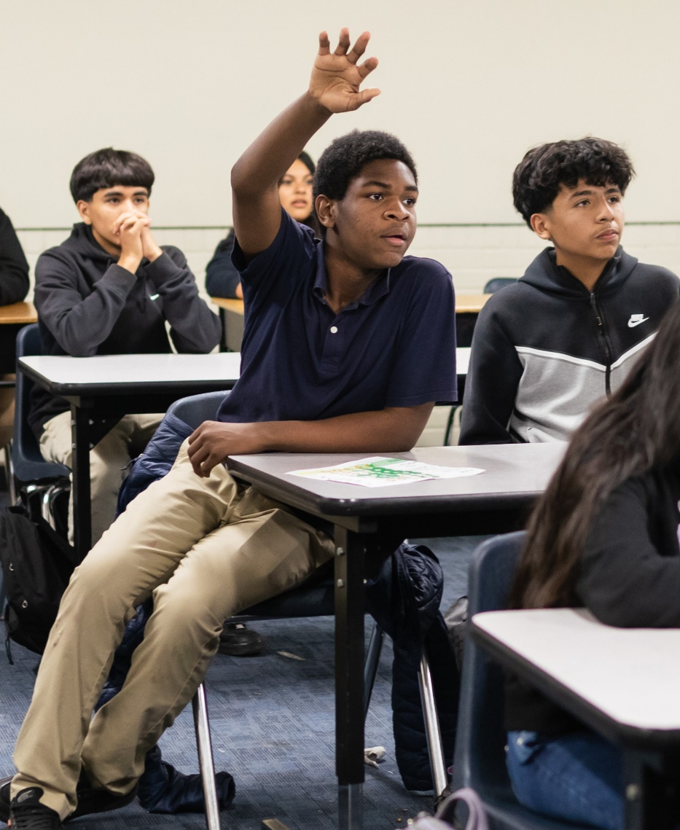
Middle School Engagement
Middle School Students:
Are developing their own opinions & identities
Can be easily influenced by personal interests
Are looking for opportunities to contribute & share ideas
Notes:
STUDENT ENGAGEMENT: MIDDLE SCHOOL
SAY:
Middle school students are going to be in grades 6-8
These students are generally:
Developing their own opinions and identities
Influenced by their personal interests
Finding their voice and looking for meaningful ways to contribute and share their ideas. The want to feel valued and heard.

Slide 30
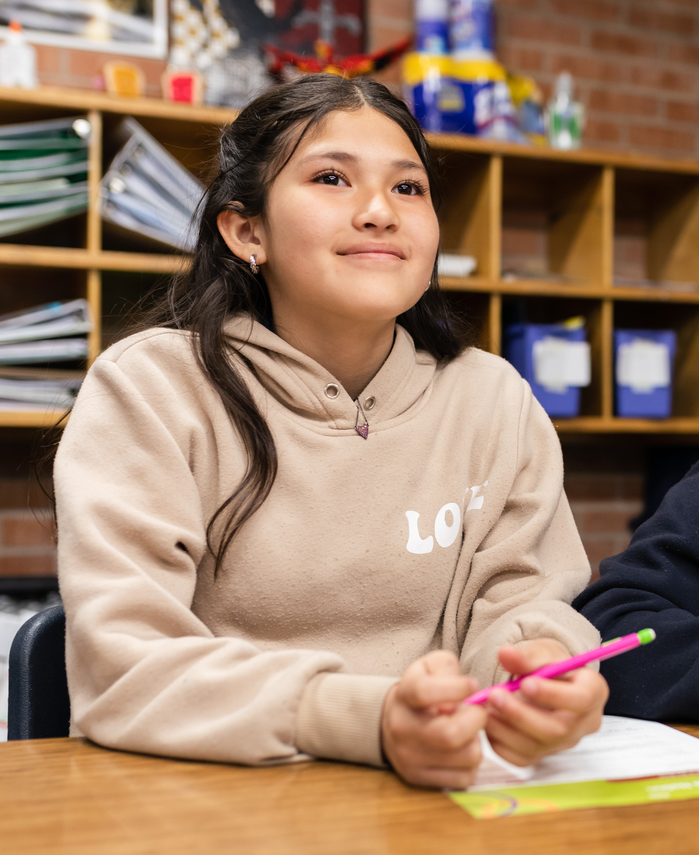
Middle School Engagement
Engagement Tips:
Connect concepts to students’ interests
Encourage discussion & opinion
Avoid long lectures
Give students opportunities to share ideas
Notes:
STUDENT ENGAGEMENT TIPS: MIDDLE SCHOOL
SAY:
With that in mind, you will be most successful in a middle school classroom if you:
Try to connect the concepts to student’s interest
ASK: What is a strategy you’ve already learned about in this training that you can utilize to your advantage to learn more about students’ interests at the beginning of your visit? (Answer: Ice breakers)
Keep things fun by encouraging discussion and opinions so students can share their ideas.
Utilize pair-sharing or group work to give students time to share ideas before coming to the larger group.

Slide 31
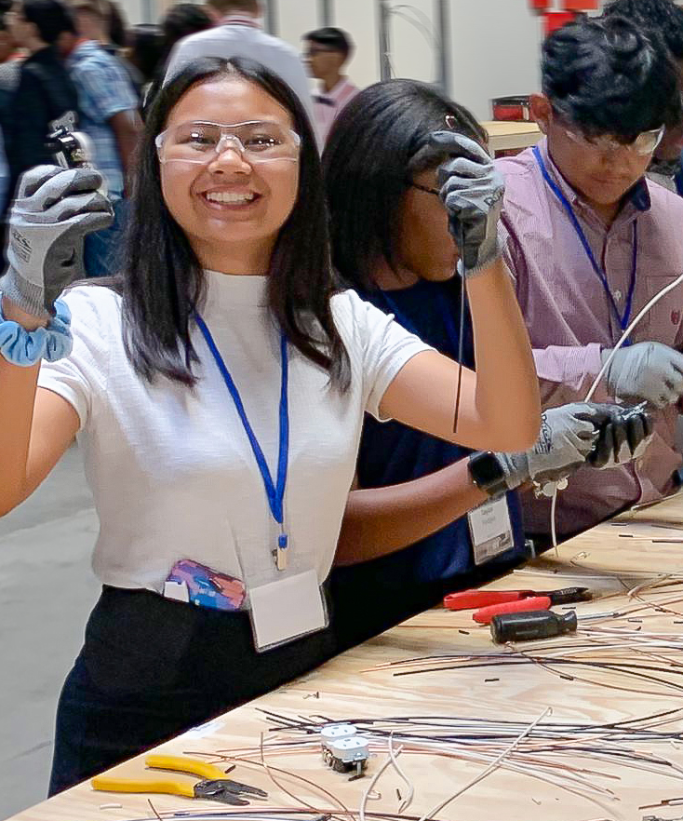
High School Engagement
High School Students:
Are thinking actively about their futures
Might be already working, saving money, thinking about their career goals
Value authenticity & practical information
Want to understand how learning connects to real opportunities
Notes:
STUDENT ENGAGEMENT: HIGH SCHOOL
SAY:
High school students are going to be in grades 9 - 12
These students are generally:
Already thinking of their futures!
Many are already working, saving money and thinking about their career goals
Want to know how learning is connected to real life (they may ask, “When will we use this in the real world?”)

Slide 32
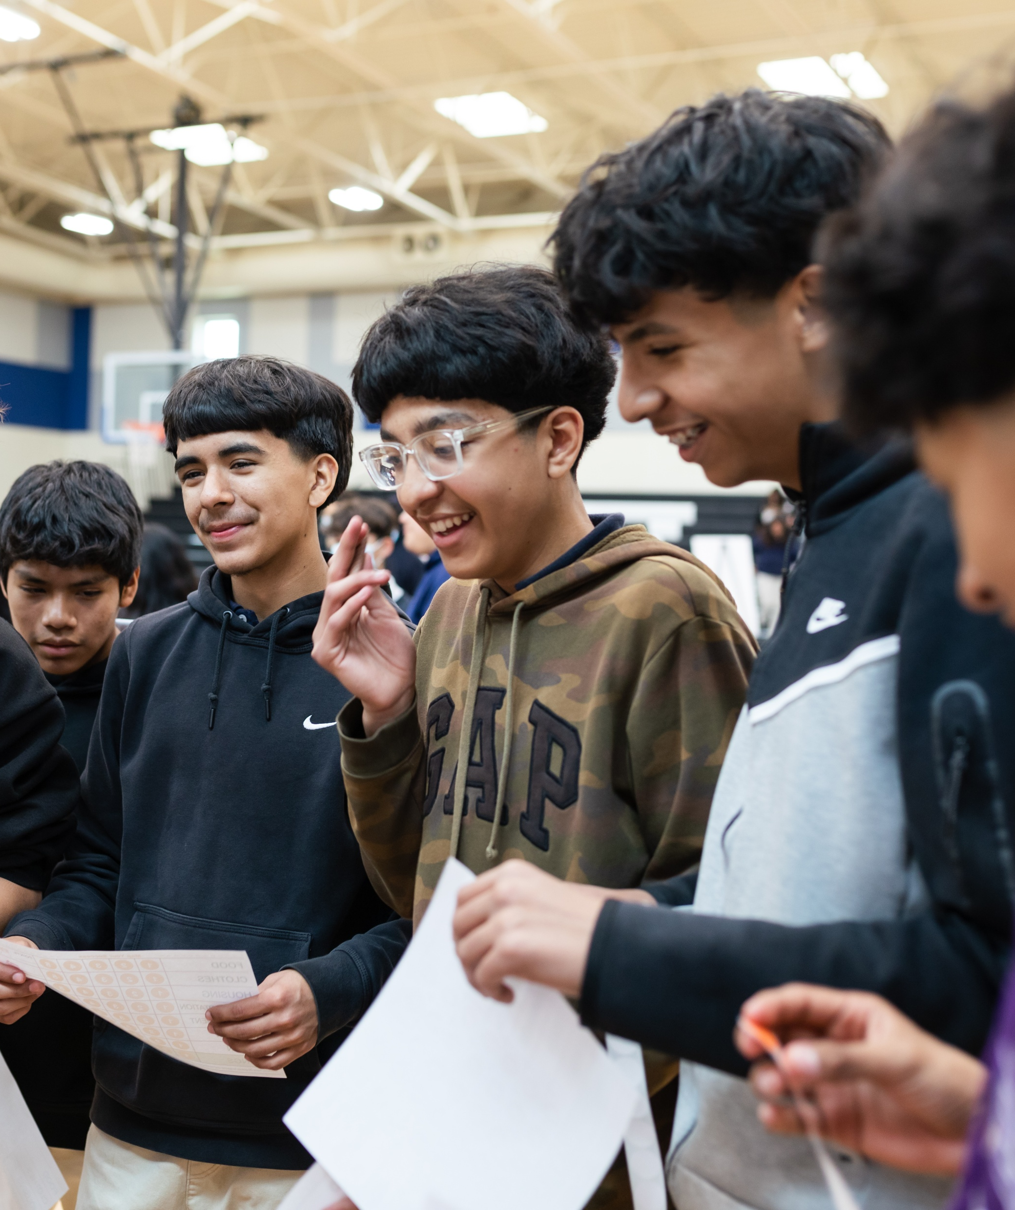
High School Engagement
Engagement Tips:
Share your personal career journey
Use real-world examples
Be honest about challenges and lessons learned
Give students opportunities to share ideas
Notes:
STUDENT ENGAGEMENT TIPS: HIGH SCHOOL
SAY:
When entering a high school class, you might want to:
Share your personal career journey
Use real-world examples
Be honest about challenges and lessons learned
Ask about students’ goals and interests; Highlight multiple pathways to success.

Slide 33
GRADE LEVEL
CHALLENGE
Can you identify the best-fit approach for each age group?
You may encounter similar situations in any classroom, but students at different ages often respond best to different approaches.
1.
2.
3.
4.
READ THE SCENARIO
REVIEW THE THREE STRATEGIES
GUESS WHICH STRATEGY IS BEST SUITED FOR:
Elementary School
Middle School
High School
SHARE YOUR ANSWER
Use this strategy:
Gamifying learning helps with information retention and keeps learning fun!
Notes:
STUDENT ENGAGEMENT: GRADE LEVEL CHALLENGE
SAY:
Let’s put what we’ve reviewed into practice with a quick game that will present us with scenarios you might encounter while volunteering, and it is our job to figure out how to approach based on what age group we are dealing with.
Here’s how the game goes:
CLICK
SAY:
First, we will read a scenario.
CLICK
SAY:
Then, we will review the three strategies that we could use.
CLICK
SAY:
After, everyone will guess what strategy is best suited to the different age groups,
CLICK
SAY:
Then, we will share our answers and reasoning either by unmuting or by typing it in the chat.
CLICK
SAY:
Gamifying learning is a great way to keep students engaged. The JA Curriculum is very hands-on and already includes plenty of games as part of the lessons. Don’t be afraid to lean into that when reviewing material …

Slide 34
SCENARIO A
STRATEGY 1
ES
1.
All the students take turns going around answering the question, "If you had a superpower, what would it be?"
You and your partner enter your JA classroom for the first time, and you would like to start the day with an icebreaker to get to know the students.
Match the strategy to the age group where it would be MOST effective.
STRATEGY 2
MS
2.
Have the students play a few rounds of “Stand up if..." game with fun interests and preferences.
STRATEGY 3
HS
3.
Ask a few volunteers/call on a few students to answer the question, "What's one skill or strength that will help you in your future career?"
Notes:
STUDENT ENGAGEMENT: GRADE LEVEL CHALLENGE
Volunteers will use the scenario and the three strategies; then they will match the strategy to the age group where it would be MOST effective (Elementary School (ES). Middle School (MS), or High School (HS))
INSTRUCTIONS:
FIRST, read the scenario
THEN, reveal each of the 3 strategies by CLICKING. Make sure to take time to read each one before moving forward.
AFTER, give volunteers a moment to guess what strategy would be most effective for the grade groups by either unmuting or typing in the chat.
FINALLY, reveal the correct answer by CLICKING. Make sure to stop and discuss why those strategies are the better match.

Slide 35
SCENARIO B
STRATEGY 1
HS
1.
Start with a thought-provoking question, current event, or real-world connection that relates to the lesson and invite students to share opinions.
Students return from lunch. They seem tired, sluggish, and reluctant to participate in whole-group discussion.
Match the strategy to the age group where it would be MOST effective.
STRATEGY 2
ES
2.
Lead a quick movement activity ("Stand up if...", stretching, hand motions, or a fast energizer) before transitioning back into the lesson.
STRATEGY 3
MS
3.
Have students discuss a question with a partner or small group before sharing with the whole class.
Notes:
STUDENT ENGAGEMENT: GRADE LEVEL CHALLENGE
Volunteers will use the scenario and the three strategies; then they will match the strategy to the age group where it would be MOST effective (Elementary School (ES). Middle School (MS), or High School (HS))
INSTRUCTIONS:
FIRST, read the scenario
THEN, reveal each of the 3 strategies by CLICKING. Make sure to take time to read each one before moving forward.
AFTER, give volunteers a moment to guess what strategy would be most effective for the grade groups by either unmuting or typing in the chat.
FINALLY, reveal the correct answer by CLICKING. Make sure to stop and discuss why those strategies are the better match.

Slide 36
SCENARIO C
STRATEGY 1
MS
1.
Ask students to turn to a partner and explain what they think the directions are, then clarify any misunderstandings for the whole group.
After explaining an activity to the class, students look confused and say, "I don't get it," "Wait, what are we doing?" or are giving you blank stares..
Match the strategy to the age group where it would be MOST effective.
STRATEGY 2
HS
2.
Ask students targeted questions to identify exactly where they're confused and connect the activity back to the overall goal or real-world application.
STRATEGY 3
ES
3.
Slow down and model the first step yourself. Use simple language and ask students to show a thumbs up/down to check understanding before moving on..
Notes:
STUDENT ENGAGEMENT: GRADE LEVEL CHALLENGE
Volunteers will use the scenario and the three strategies; then they will match the strategy to the age group where it would be MOST effective (Elementary School (ES). Middle School (MS), or High School (HS))
INSTRUCTIONS:
FIRST, read the scenario
THEN, reveal each of the 3 strategies by CLICKING. Make sure to take time to read each one before moving forward.
AFTER, give volunteers a moment to guess what strategy would be most effective for the grade groups by either unmuting or typing in the chat.
FINALLY, reveal the correct answer by CLICKING. Make sure to stop and discuss why those strategies are the better match.

Slide 37
RESOURCES
The tools you need to bring it all together.
Notes:
TRANSITION : REVIEWING RESOURCES
SAY:
We’ve just reviewed a lot of information!
Let’s close off the training by looking at some tools that are going to help you feel prepared to enter the classroom.

Slide 38

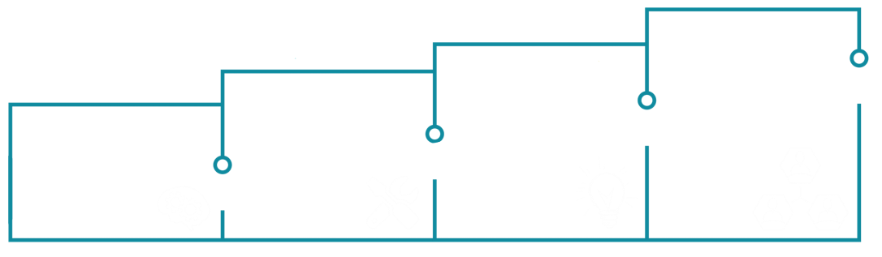
NEXT STEPS
EDUCATOR
CONNECTION
PERSONALIZE
& PRACTICE
Connect with your educator before going into their class. They will be supporting your entire visit with classroom management &
technology. Ask
them for tips,
feedback &
guidance before
& during your
visit!
REVIEW RESOURCES
Review the sessions in your facilitator guide, prepare your physical materials & coordinate with your partner(s). Preview any
technology you’ll be
using in the classroom
& reach out to your JA
Contact with any
questions.
VERIFY
ASSIGNMENT
Visit the (password protected) JA Volunteer portal on the JAAZ website that houses helpful resources like
how-to videos, this presentation & the JA
Volunteer planner.
Your JA Contact will email you about your grade placement, your schedule, & physical materials.
Notes:
REVIEWING NEXT STEPS
SAY:
Your JA Volunteer Journey is just getting started. We want to make sure that you know what to expect after this training.
CLICK
First thing you should be looking out for is communication from your JA Contact verifying your grade placement. We will also work with you to get you/your partner a physical kit of materials.
If your kit will not be made available until a future date, JA staff will let you know.
CLICK
Next, make sure to visit the JA Volunteer Portal on our website. It has all the tools you need to prepare.
CLICK
Make sure to connect with your partners (if you have any) and review your guides, open your kits and prepare your materials. If you have any questions, please do not hesitate to contact us, we are here to help!
CLICK
You will also be introduced to your teacher leading up to your volunteer event. They will be helping with classroom management and technology during your visit. Ask them any questions you have.

Slide 39
What Else?
Use this strategy:
Suggest open-ended questions. Count to 10.
More About Preparing:
More Student Scenarios:
More About Logistics:
A. What resources can help me do my best?
D. How do I engage students who don’t speak English very well?
G. What if the technology fails?
B. What should I wear?
E. What can I do if I feel like I’m floundering?
H. How early do I need to arrive?
C. What will my schedule be like? Is there lunch?
F. What are some ways to incorporate movement?
I. How often should we take breaks?
Notes:
REVIEWING RESOURCES: YOUR JA STAFF/FAQ
SAY:
JA Staff is always at your disposal!
It is our responsibility to ensure that volunteers feel prepared to go into the classroom and answer any questions you may have.
On the screen are some of our most-frequently asked questions. If you’d like the answer to any of these, or if you have a question of your own, now is the time to ask!
(Time Permitting)
DO: Pause for 10 Seconds and point out the “Use this strategy” box
SAY:
students usually need a moment to think of their answers or process a question they are presented.
Don’t be afraid of the awkward silences.
It allows the kiddos to learn!

Slide 40
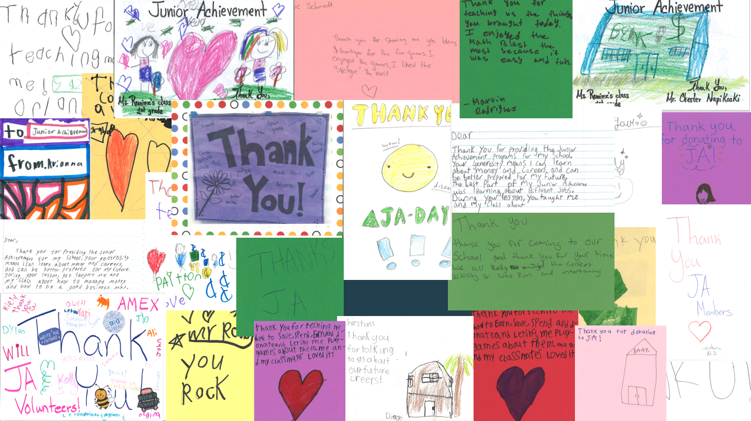
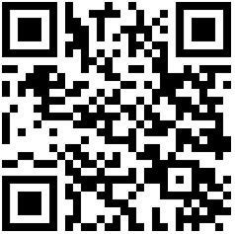
Because of You…
1.5M+
8,000+
$38
Students served in Arizona
Annual
Volunteers
Cost to reach one in-classroom student
Notes:
WRAP- UP: DONATION ASK
(NOTE: If you are running out of time – try to finish on this slide.)
SAY:
Thank you so much for being here and taking the first step to becoming volunteer mentors!
It takes over 8,000 volunteers each year to make JA Programs happen.
JA of Arizona has served over1.5 million students since it’s founding and your presence here is helping that number grow!
It takes $38 to reach one student.
JA is fully donor-funded. If you’d like to double your impact, consider donating via our website or the QR code on the screen.
JA is a AZ Qualifying Charitable Organization. This means that if anyone donates as much as $1 or max out their tax credit, they will get that deducted from their state taxes when they file.

Slide 41

Why Junior Achievement?
Notes:
WRAP- UP: VOLUNTEER TESTIMONY
Time Permitting—Show Soketh’s Video. Ensure audio is enabled.

Slide 42
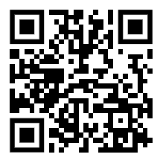
THANK YOU!
Help us keep improving:
Give us feedback on this session so we can ensure our volunteers feel ready to go!
Notes:
WRAP- UP: VOLUNTEER TRAINING FEEDBACK
SAY:
We are now at time! Thank you all so much for being here!
One last thing before you go:
We are always working to improve so if you have any feedback about this training, you can submit it anonymously by scanning the QR Code that is currently on the screen!

